Slide 1
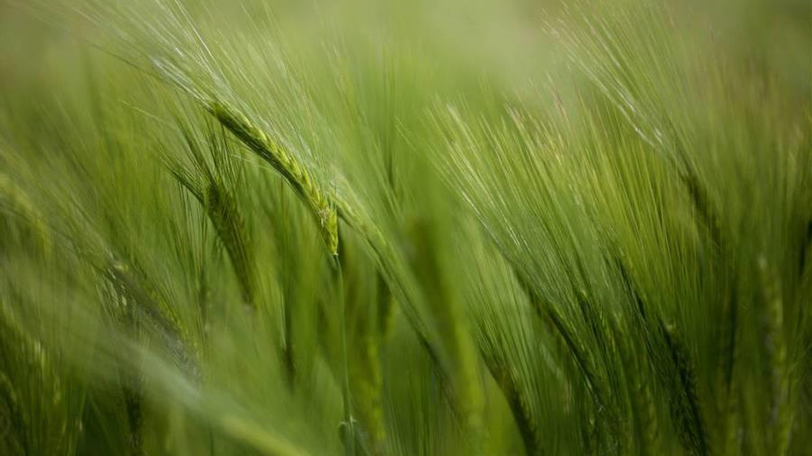
DEMAND, DEVELOPMENT & self sufficiency opportunities

Slide 2
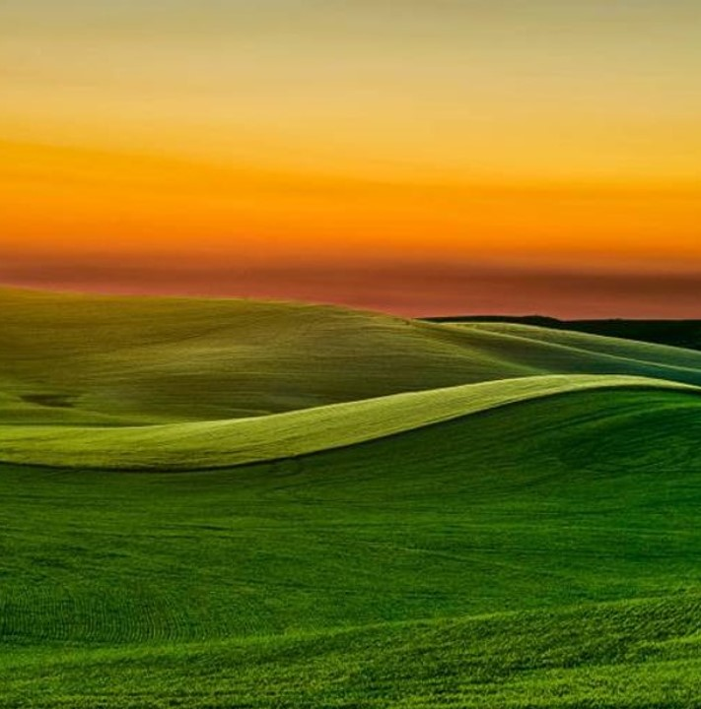
AGENDA
*EQUINE AMENITIES DEMAND, LACK OF AVAILABLE SPACES ESPECIALLY CLOSE-IN!
*UNIQUELY POSITIONED FOR OUR LOCAL COMMUNITY YOUTH TO ACCESS
*ABILITY TO ENSURE AGRICULTURE HERITAGE & NATURE ECHOED IN ORIGINAL GIFTED INTENT
*AVAILABLE INCOME FOR SELF SUFFICIENCY
*OFFER FROM EXPERIENCED OET MEMBERS TO ASSIST WITH HELP OBTAINING GRANTS
*INCREASED PUBLIC PARK USE DRIVES REVENUE INTO OUR LOCAL ECONOMY SUCH AS RESTAURANTS AND SHOPS.

Slide 3
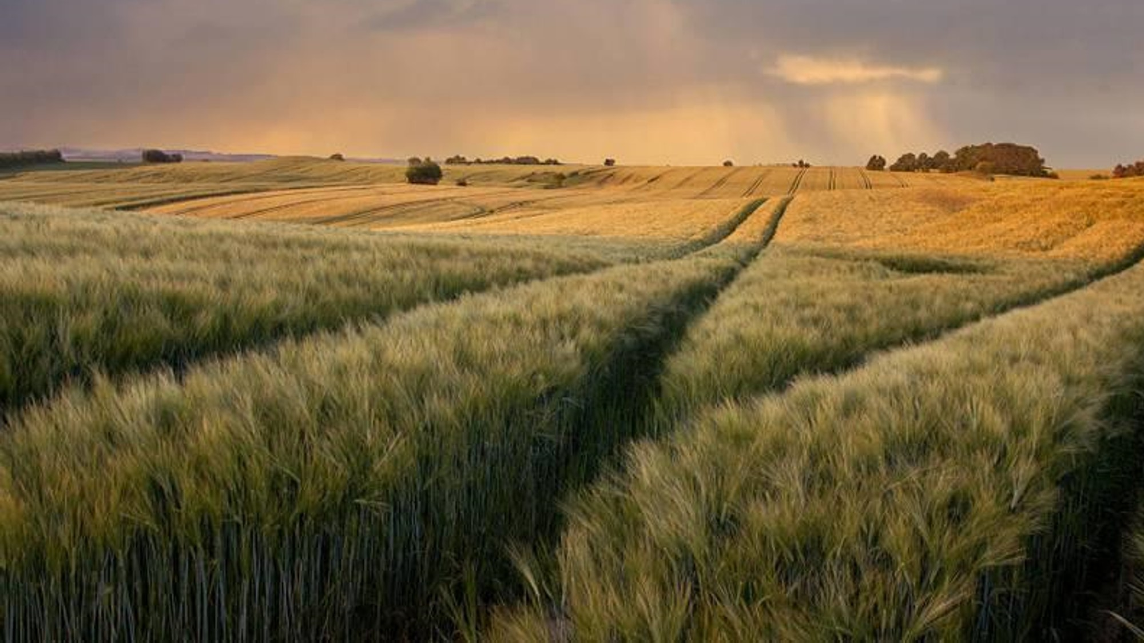
2023 National equine economic impact report reveals $177 billion contribution

Slide 4
TWO-Part TRAILS & ARENA Reviews comparable FEES
ALL VENUES ARE BOOKED YEAR-ROUND THROUGHOUT SUMMER & WINTER SEASONS
Trail obstacle courses:
Perrydale $50.00
Oregon Horse Center $45.00
Richland WA horse park $58.00
Mt Hood Center $100.00 limited monthly pass
McIver Park $30.00 annual state park pass
Arena rentals:
OHSET $500 per year
Delashmutt Arena $850.00 per day
Sheriff Posse $200 a quarter
Drader Arena $45.00 an hour
4-H & youth $90.00+ per month
Saddle clubs $250.00 family - $125.00 individual per year
IEA interscholastic $200.00 a year
Private clinicians $200+ per person on average per day

Slide 5
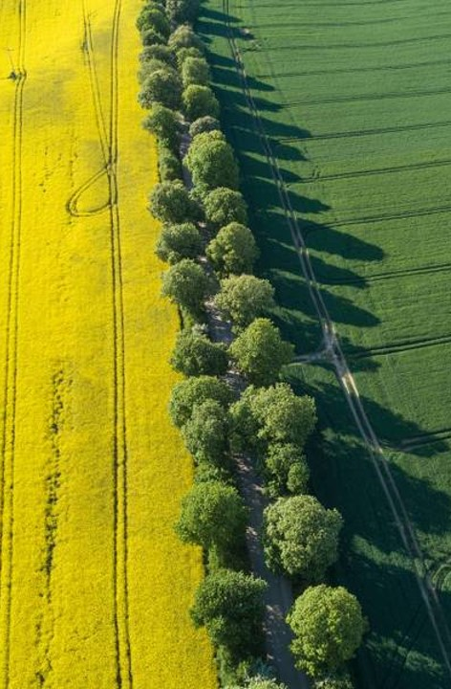
Arena, Obstacles &
OPEN YEAR-ROUND TRAILS
IN-PLACE DEMAND SUPPORTS INVESTMENT AND ENABLES MORE COMMUNITY ACTIVITIES, ONLY SOME OF WHICH ARE LISTED ON THE PREVIOUS SLIDE.
YEAR-ROUND TRAILS ALLOW THE PUBLIC TO EMBRACE NATURE AND THE OUTDOORS. TRULY UTILIZING THE PARK AND KEEPING TRUE TO THE DONORS VISION.
ON SITE TRAIL USERS PROMOTE AWARENESS AND SAFETY FOR THE PARK IN IT’S ENTIRETY. NATURALLY DETERS NEFARIOUS CHARACTERS.

Slide 6
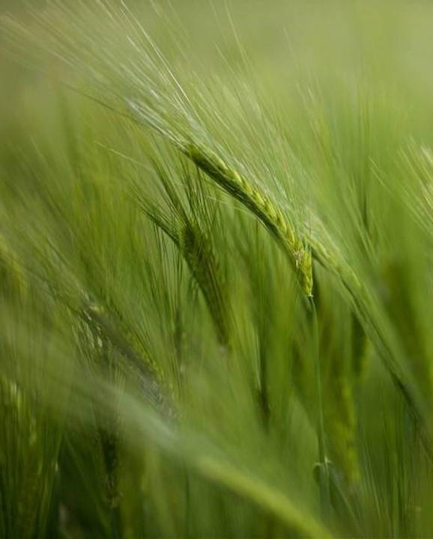
Development of year-round trails, natural obstacles & AMENITIES
www.AmericanTrails.org
Following best practices: Compacted gravel along horse trails is the best suited for PAC NW Weather and the Impact of 1,200LBS hooves
OET is one of the well-versed volunteer groups willing to aid in development THROUGH THEIR VAST experiences.

Slide 7
“The mission of Chehalem Park and Recreation District is to connect and enrich our community through parks, recreation, open space, natural resources, and educational opportunities.”
THE CRYSTAL RILEE PARK TRAILS ARE RELATIVELY UNKOWN - YOUR INVESTMENT GOES A LONG WAY IN SPREADING THE WORD! YOU HAVE THE OPPORTUNITY NOW TO ENSURE THIS UNIQUE PARK STAYS A LOCAL LEGACY!
*If you build it, they will come, the data supports it! Capitalize on this ideal location, our active local demographic and have the benefit of income generation for self-sustainability.
*Preserving the agriculture heritage, promoting outdoor activity and community enjoyment speaks to the integrity of our locally elected and hard working CPRD officials.

Slide 8
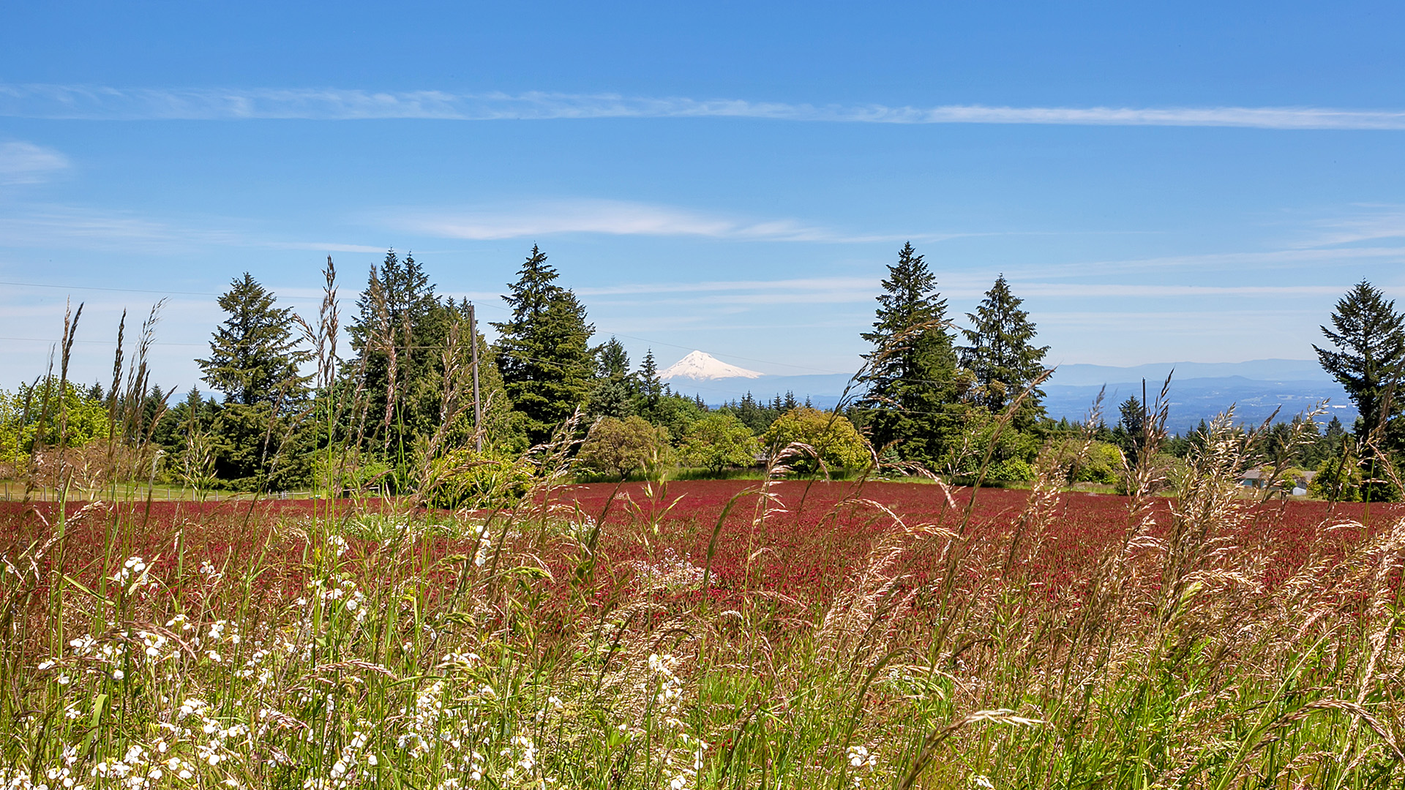
Final takeaways
Grants Available
Demand for Venues
Willing Volunteers
Income Production
Maintaining Agricultural Appeal
Maximum Resource Stewardship
Finalizing a 10+ year long project
Community Enrichment

Slide 9
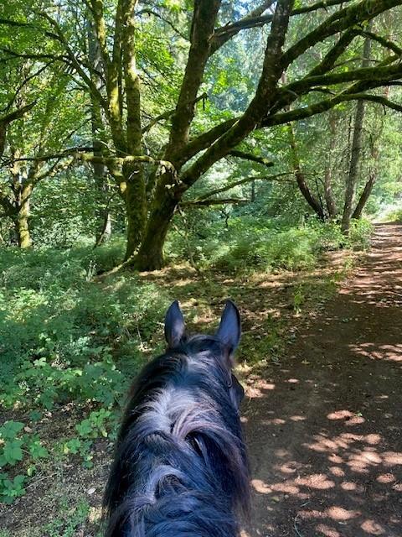
Thank you
The Crystal rileE park equestrians in collaboration with Oregon equestrian trails
Special thank you to Melissa Mcloughlin, Danna Kemp, Lauren Pfeiffer, Hope Robertson and ALL the actively involved hikers and horsemen who’ve contributed their time and input!

