Slide 1
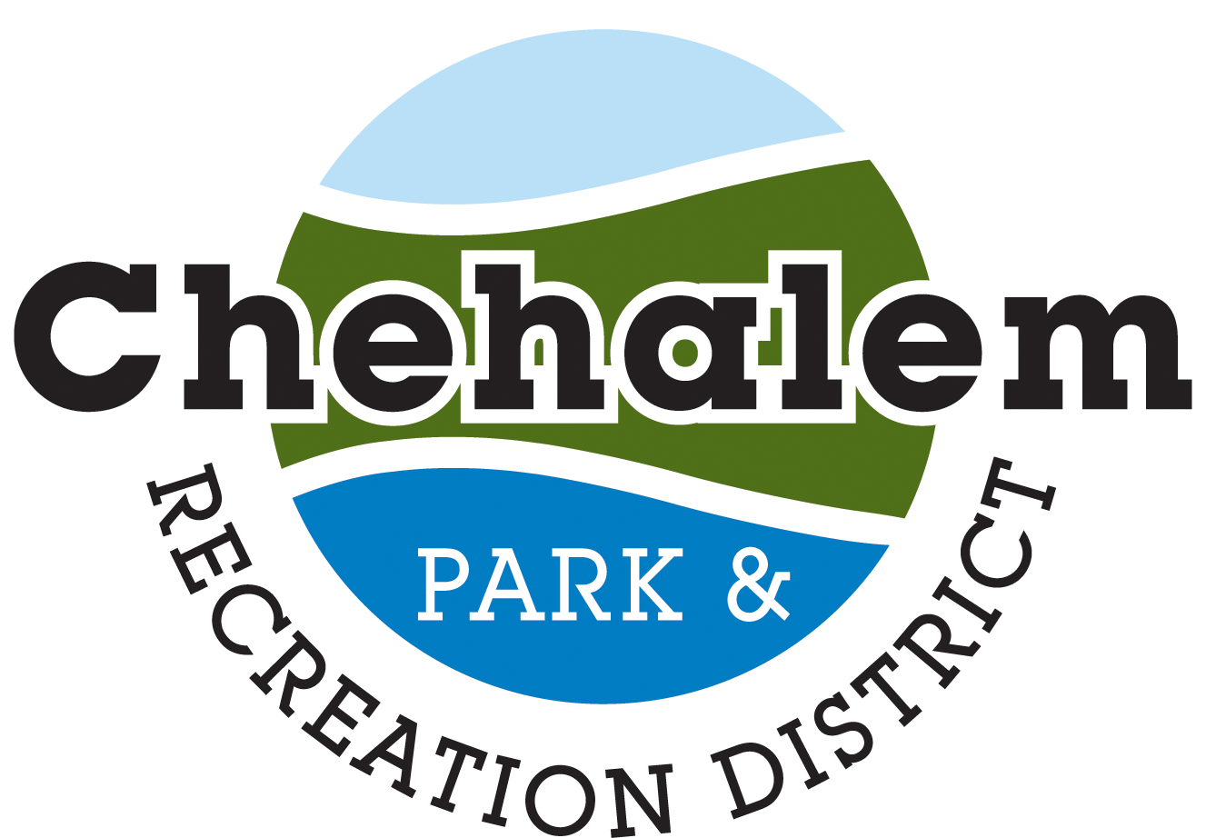
Ewing Young Park
Ewing Young Park Trail Bridge Proposal

Slide 2
Brief Project Description
Popular Ewing Young Park and its trail (total 46 acres) require a bridge crossing in order to access 11 undeveloped acres located on the west side of Chehalem Creek (Plans include an additional .55-mile proposed trail).
This bridge will allow a point of access by trailhead from either side of the creek, introducing a new point of entry from a housing development which is currently under construction, which will meet our park and trail masterplan goals, by
capturing the solicited and documented desire of the community for outdoor trails, as well as our agency mission, "to connect and enrich our community through parks, recreation, open space, natural resources, and educational opportunities," while respecting the constraints of the land and minimizing negative impacts.

Slide 3
The Ewing Young Park Master Plan came about with reference to the Chehalem Heritage Trail Strategic Plan, which was completed in April of 2010. Its goal was to create an outstanding 70+ mile trail system that links the Greater Newberg-Dundee area through parks, historic preservation, habitat restoration, multimodal transportation, education, and tourism.

Slide 4
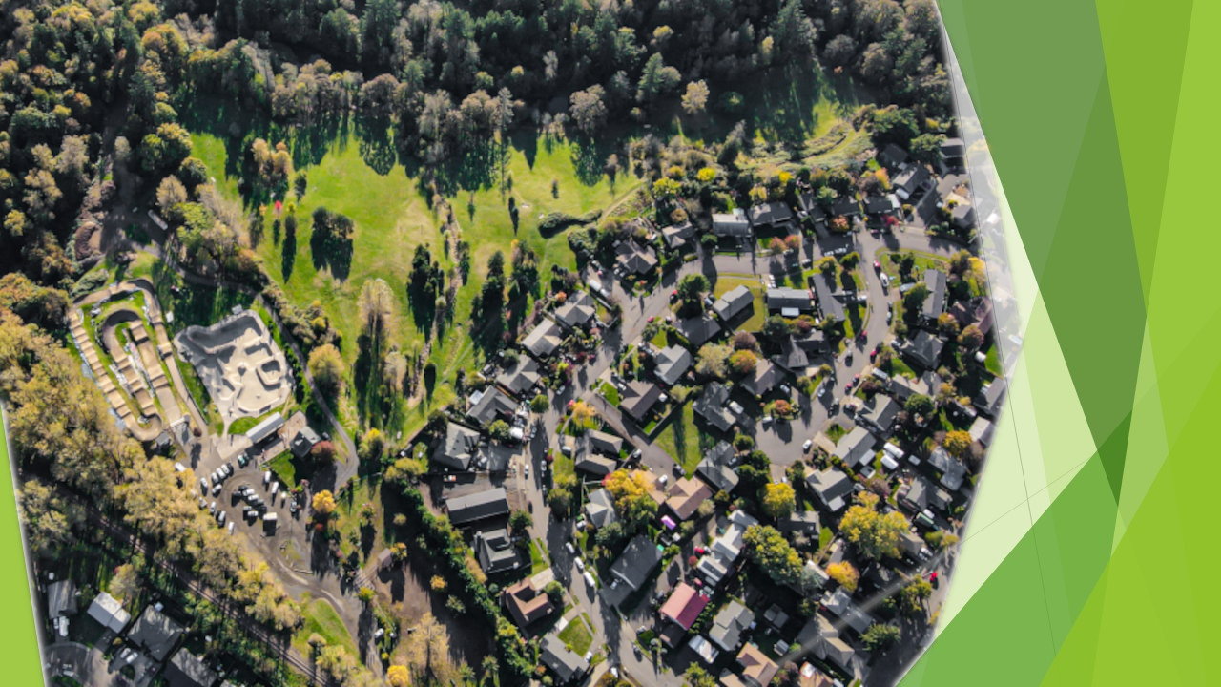
Ewing Young Historical Park has quite a history as a one-time brick factory, saw mill, grist mill, a city dump, a stagecoach crossing of Chehalem Creek, and a swimming hole once favored by Herbert Hoover and the DAR.

Slide 5
The addition of 3.6 acres deeded to Chehalem Park & Recreation District has increased Ewing Young Park to 50.6 acres, which includes a paved pedestrian walkway to Ewing Young Park from the new residential development located on the south side of the park. Eleven acres are inaccessible because of the passage of Chehalem Creek through the park.

Slide 6
Bridging Chehalem Creek will allow for the development of the 11 inaccessible acres by means of additional trails and expansion of the disc golf course, and will also provide recreational and community trails throughout the park. The property is almost entirely within the 100-yr. floodplain, so development would be limited, but it can be developed as proposed – open space, trails, a natural area and expansion of the disc golf course.

Slide 7
Representation of Bridge
Construction of Ewing Young Trail Bridge will provide access to natural area viewpoints for wildlife, native plant and waterway species.
The bridge will allow for the conservation of the stream corridor, undeveloped park, and greenway areas allowing public access.
It will result in the addition of .5 miles of level walking/hiking trails for all abilities and offer physical and psychological health benefits to park users.

Slide 8
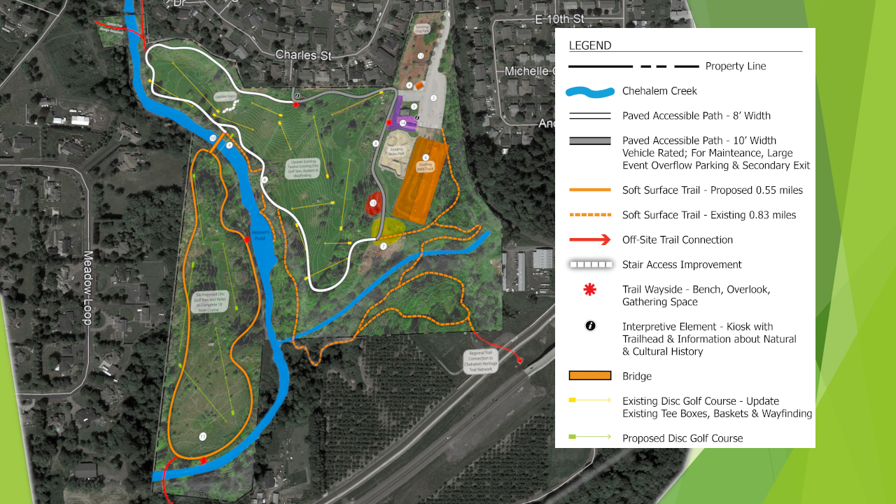
Proposed Bridge Location

Slide 9
There are both forested and shrub/emergent wetlands present in the park. Forested wetland pockets are found along the streams.
The dominant tree species are Western Red Cedar and Oregon Ash, with shrubs such as Red Osier Dogwood and Pacific Ninebark.
Slough Sedge and Lady Fern are the typical herbaceous species.
The shrub/emergent wetlands that form a fringe down the small drainage area described above are dominated by Willows, Red Osier Dogwood, Pacific Ninebark, rushes and grasses.

Slide 10
Chehalem Creek has been identified as a spawning ground for Chinook salmon and is home to black-tailed deer, skunk, raccoon, opossum and coyote. Various local bird populations include scrub jays, orioles, goldfinch, hummingbirds, songbirds, woodpeckers, red-tailed hawk and heron.

Slide 11
Disc Golfers go to the course almost every weekday, even in the rain, as long as it is not too wet.
People who don’t play disc golf still use the course to walk on, as well as hiking the dedicated trails.
There is documented community support for the expansion of the disc golf course to 18 holes, using the entire park property.
Expansion would give variety to the disc golf community and access to the entire parkland.
This would be a low impact use, since extending trails across the creek despite it being in a potential floodplain would not present an issue to users.
It would allow disc golfers to market more tournaments, resulting in increased usage.

Slide 12
Estimated project state and end dates
Environmental Site analysis and Master Plan: Completed March 2019
Preliminary discussions with City of Newberg and Yamhill County Planning Departments: 2018 - present
Construction dates: 2021 - 2022
Location: Ewing Young Park, 1201 South Blaine Street, Newberg OR
Map Tax Lot: R 3219 00700

