Slide 1
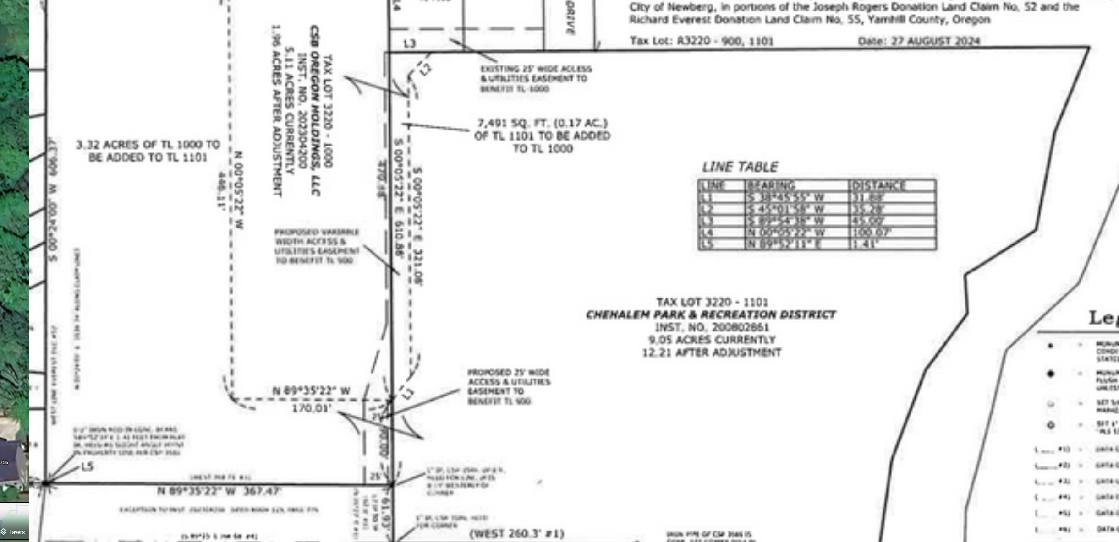
Developer proposed adjustment

Slide 2
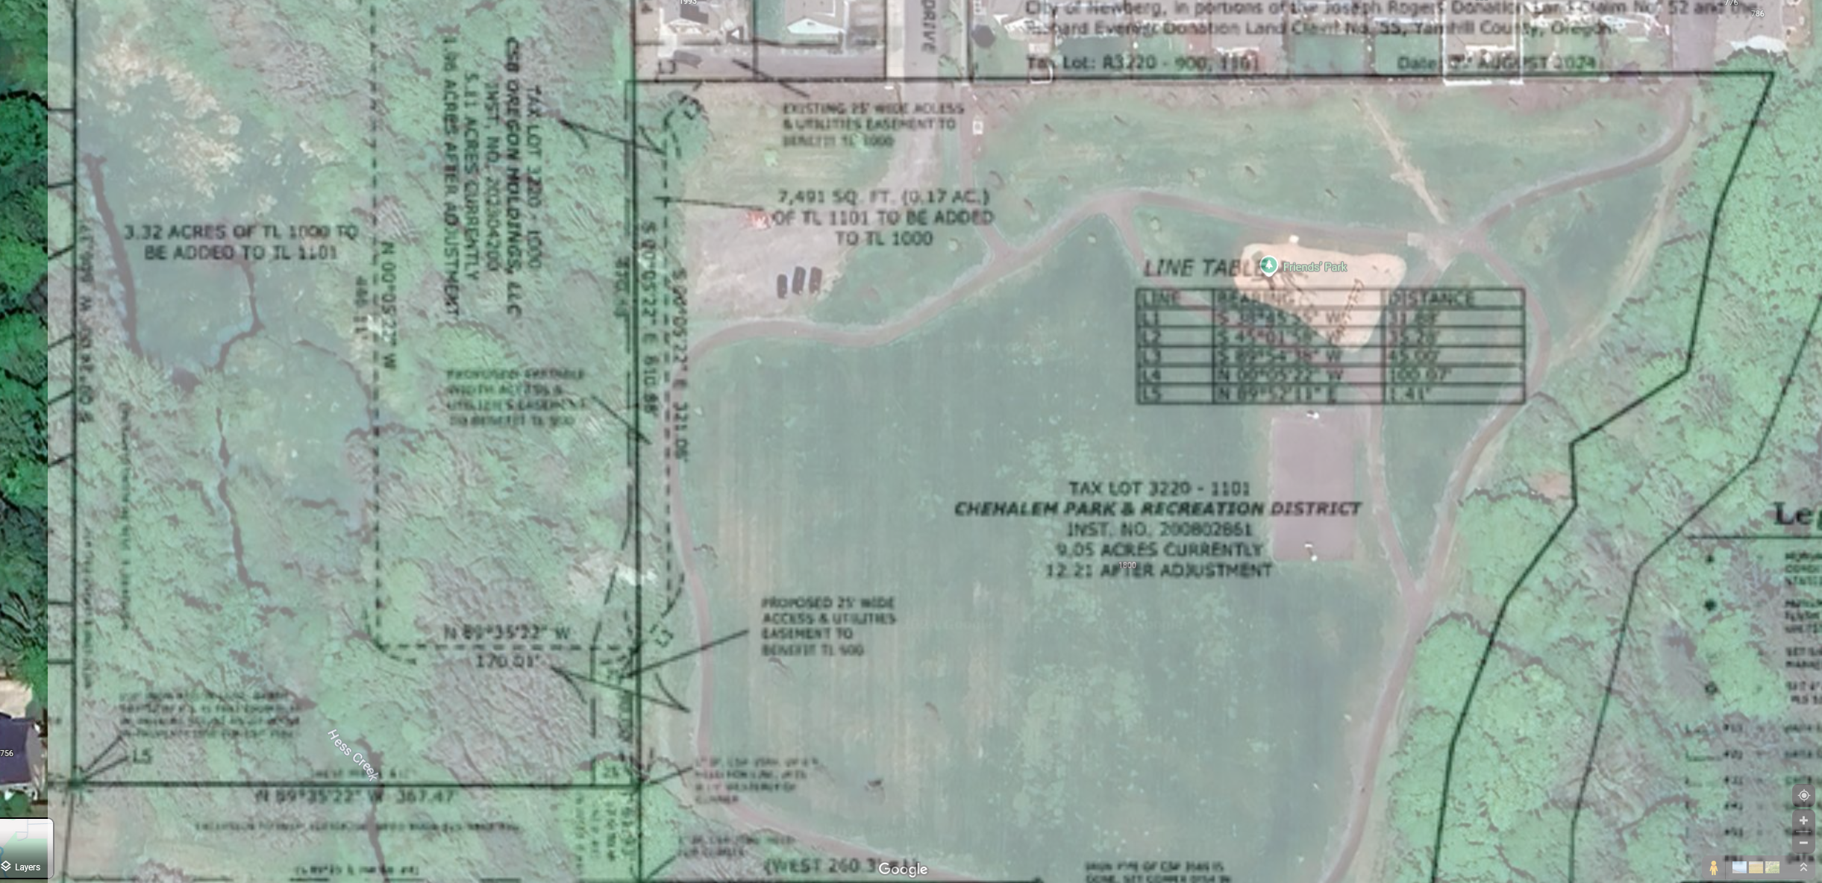
Overlay of park

Slide 3
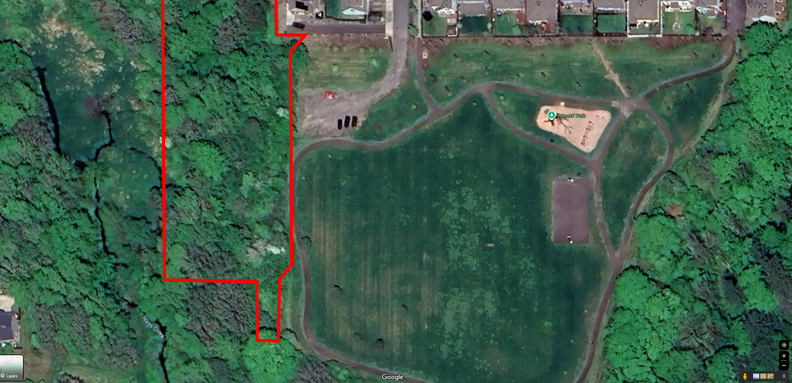
Tree line lost, trail at risk

